Slide 1

The Technology Value Stream
Module 1.2 Assignment | Rajesh Ayyappanpillai | 10/23/2024

Slide 2



Overview
Defining Lead Time vs. Processing Time
Deployment Lead Times Requiring Months
The DevOps Ideal: Deployment Lead Times of Minutes
The Role of Technology in Optimizing Value Streams

Slide 3
Defining Lead Time vs. Processing Time
Lead Time vs. Processing Time
Lead Time: Total time from when a request is made until it is fulfilled, including waiting times and handoffs.
Processing Time: The actual time spent actively working on fulfilling that request.
Importance: While reducing processing time is important, decreasing lead time offers a greater impact by improving overall efficiency.

Slide 4
Common Scenario: Deployment Lead Times Requiring Months
QA
OPS
Dev
Long Deployment Lead Times
Current State in Many Organizations: Deployment lead times can stretch into months or even quarters.
Challenges:
Siloed teams (Development, QA, Operations)
Manual testing and deployment processes
Inefficient handoffs
Result: Long lead times slow down product releases and reduce competitiveness.

Slide 5
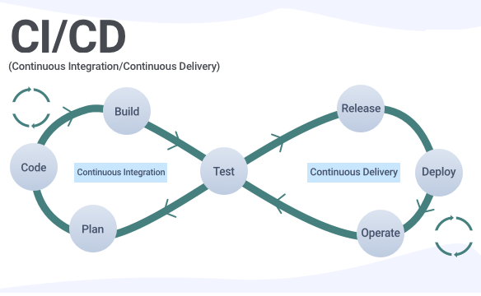
The DevOps Ideal: Deployment Lead Times of Minutes
Goal: Shift from long lead times to automated, fast deployment cycles.
How:
Continuous Integration/Continuous Deployment (CI/CD) pipelines.
Automation of testing, builds, and deployments.
Cross-functional teams working in harmony.
Benefits:
Faster delivery of features to users.
Higher-quality releases.
Ability to adapt quickly to market changes.

Slide 6
Comparing Traditional vs. DevOps Lead Times
Traditional Lead Times:
Deployment cycles measured in months.
Manual testing, slow handoffs, and risk of errors.
DevOps Lead Times:
Deployment cycles measured in minutes or hours.
Fully automated pipelines for build, test, and deploy.

Slide 7
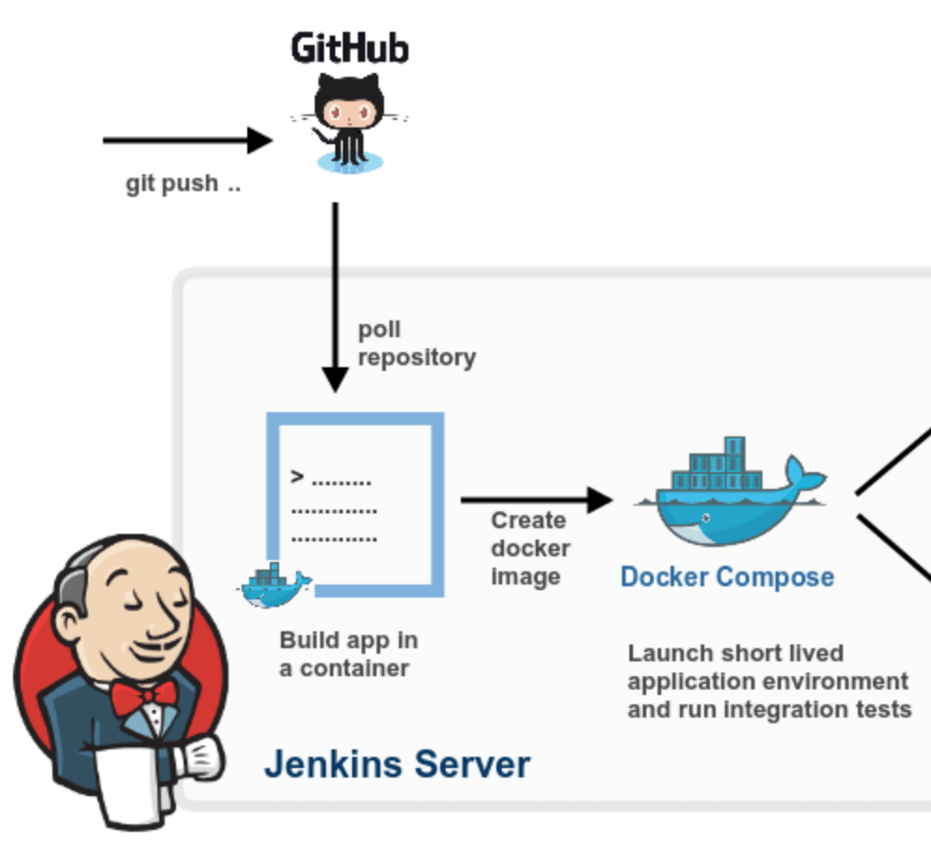
The Role of Automation in the Value Stream
Automating Processes:
Build automation, automated testing, and deployment.
Automated monitoring to catch errors earlier.
Reducing Manual Work:
Fewer handoffs and manual checks lead to faster and more reliable delivery.
Teams can focus on innovation rather than repetitive tasks.

Slide 8
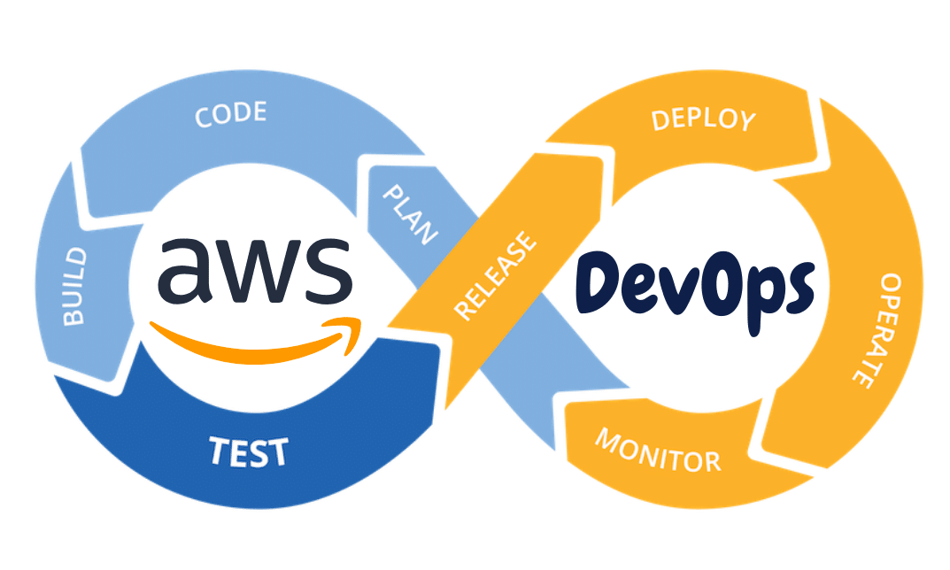
Case Study: DevOps in Action
Example Company: Amazon
Impact of DevOps: Reduced deployment times from days or weeks to minutes using continuous deployment practices.
Benefits:
Faster feature delivery.
Immediate rollback for errors, reducing downtime.
Continuous customer feedback integration into product improvements.

Slide 9
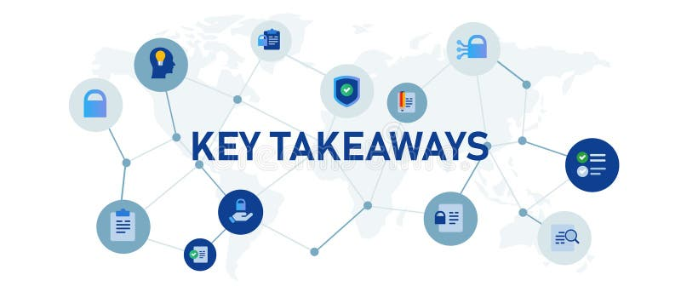
Conclusion
Summary:
Reducing lead time is crucial for improving business agility and responsiveness to customers.
DevOps practices, particularly automation and CI/CD, are key to achieving deployment lead times of minutes.
Implementing these practices transforms technology value streams, making teams more efficient and effective.

Slide 10
References
The DevOps Handbook 2nd Ed
https://dl.faghatketab.ir/Books/Computer/Programming/WebProgramming/The.DevOps.Handbook_faghatketab.ir.pdf

